Slide 1
Spatial Temporal Graph Convolutional Networks for Skeleton-Based Action Recognition
Sijie Yan, Yuanjun Xiong, Dahua Lin (AAAI 2018)

Slide 2
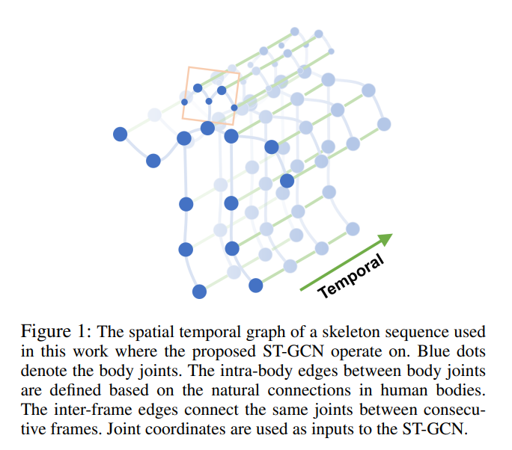
The spatial temporal graph of a skeleton sequence

Slide 3
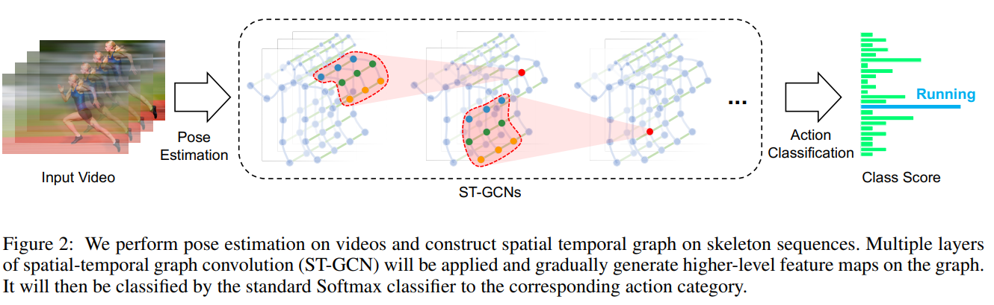
Spatial Temporal Graph ConvNet
Pipeline Overview

Slide 4
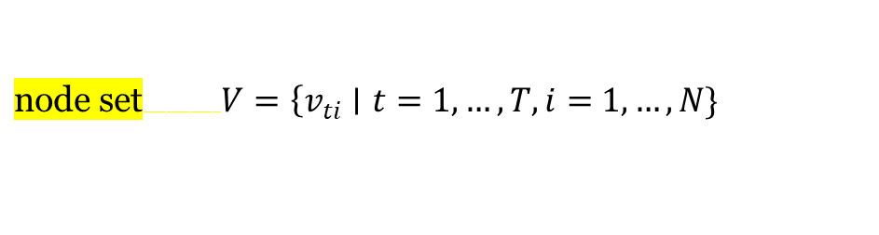
Skeleton Graph Construction
graph G = (V, E) on a skeleton sequence with N joints and T frames featuring both intra-body and inter-frame connection.
$\text{node} \text{set} V=\left\{v_{ti}∣t=1,…,T,i=\right.$ $1,…,N\}$
the feature vector on a node $F\left(v_{ti}\right)$ consists of coordinate vectors, as well as estimation confidence, of the $i$-th joint on frame $t$

Slide 5

Skeleton Graph Construction
the edge set $E$ is composed of two subsets
intra-skeleton connection at each frame, denoted as $E_{S}=\left\{v_{ti}v_{tj}∣(i,j)∈H\right\}$
the inter-frame edges which connect the same joints in consecutive frames as $E_{F}=\left\{v_{ti}v_{(t+1)i}\right\}$.

Slide 6
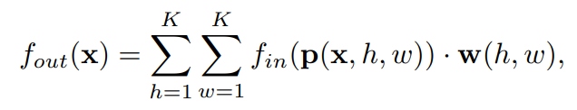
Spatial Graph Convolutional Neural Network
Recall the definition of convolution operation on the 2D natural images or feature maps

Slide 7
Spatial Graph Convolutional Neural Network
sampling function p enumerates the neighbors of location x , it can also be represented as $p(x,h,w)=$ $x+p^{′}(h,w)$.
weight function w provides a weight vector in c-dimension real space for computing the inner product with the sampled input feature vectors of dimension c.

Slide 8
Spatial Graph Convolutional Neural Network
The convolution operation on graphs is then defined by extending the formulation

Slide 9
Sampling function.
On images, the sampling function $p(h,w)$ is defined on the neighboring pixels with respect to the center location $x$.

Slide 10
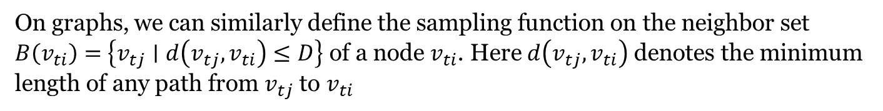
Sampling function.
On graphs, we can similarly define the sampling function on the neighbor set $B\left(v_{ti}\right)=$ $\left\{v_{tj}∣d\left(v_{tj},v_{ti}\right)≤D\right\}$ of a node $v_{ti}$. Here $d\left(v_{tj},v_{ti}\right)$ denotes the minimum length of any path from $v_{tj}$ to $v_{ti}$
$$p\left(v_{ti},v_{tj}\right)=v_{tj}.$$

Slide 11

Weight function
neighbor set $B\left(v_{ti}\right)$ of a joint node $v_{ti}$ into a fixed number of $K$ subsets, where each subset has a numeric label.
$l_{ti}:B\left(v_{ti}\right)→\{0,…,K−1\}$
$$w\left(v_{ti},v_{tj}\right)=w^{′}\left(l_{ti}\left(v_{tj}\right)\right).$$

Slide 12
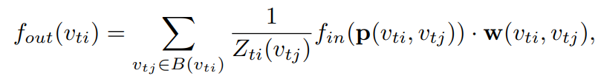
Spatial Graph Convolution

Slide 13
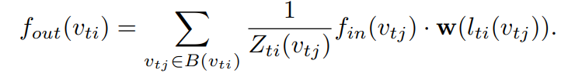
Spatial Graph Convolution

Slide 14
Spatial Temporal Modeling.
extend the concept of neighborhood to also include temporally connected joints
The parameter Γ controls the temporal range

Slide 15

Spatial Temporal Modeling.
To complete the convolution operation on the spatial temporal graph, we also need the sampling function

Slide 16
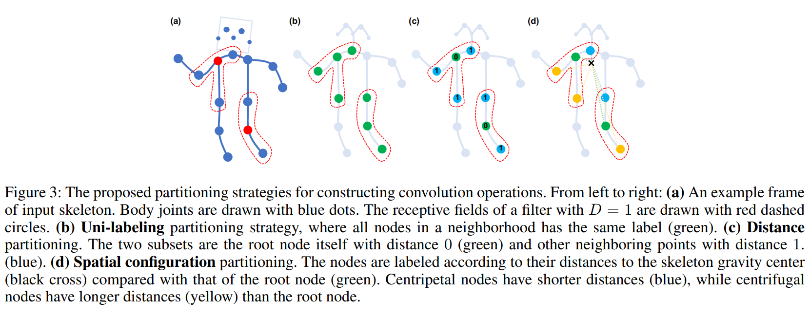
Partition Strategies
Notes:
(b)와 같이 거리가 1인 모든 노드를 하나의 subset으로 묶을 수 있고, (c)와 같이 path의 길이에 따라 weight를 준 형태가 될 수 도 있다. 마지막 (d)의 경우 해당 노드로 부터 중심노드(위의 이미지에서는 X표)와의 거리 순으로 다른 색깔로 weight를 줄 수 있다.

Slide 17


Implementing ST-GCN
adopt a similar implementation of graph convolution as in (Kipf and Welling 2017).
adjacency matrix A
identity matrix I

Slide 18
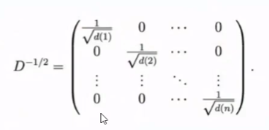

Implementing ST-GCN

Slide 19
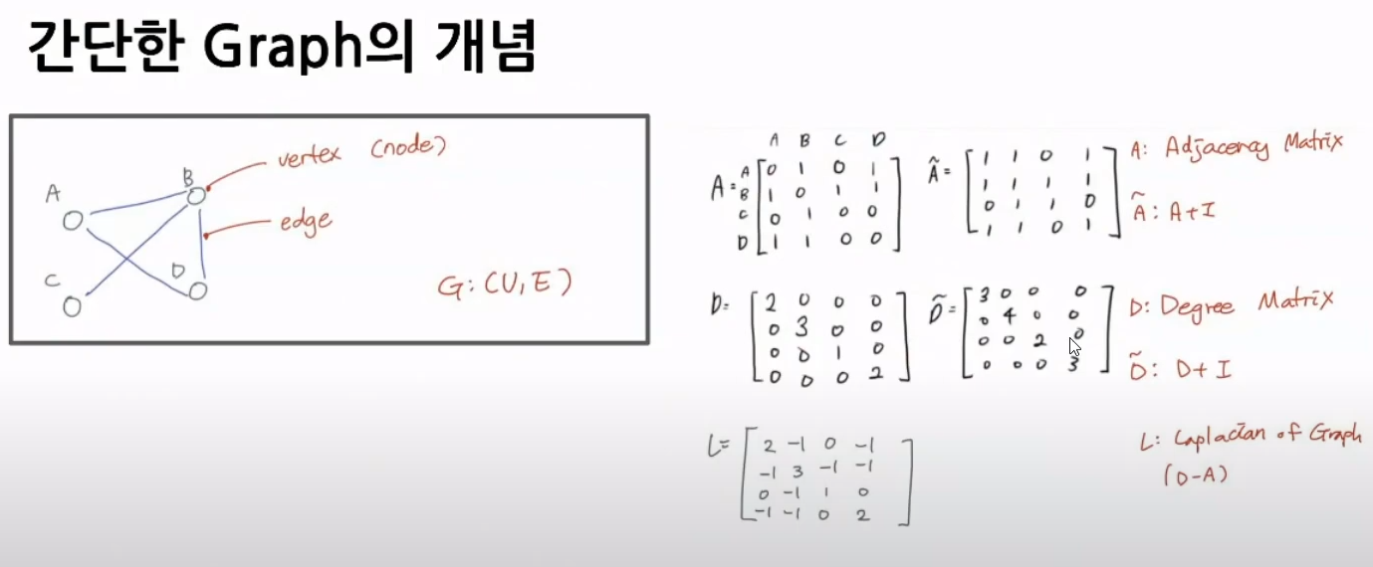
Implementing ST-GCN

Slide 20
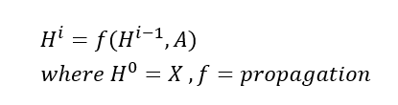

Implementing ST-GCN

Slide 21
Implementing ST-GCN
adopt a similar implementation of graph convolution as in (Kipf and Welling 2017).
adjacency matrix A
identity matrix I

Slide 22
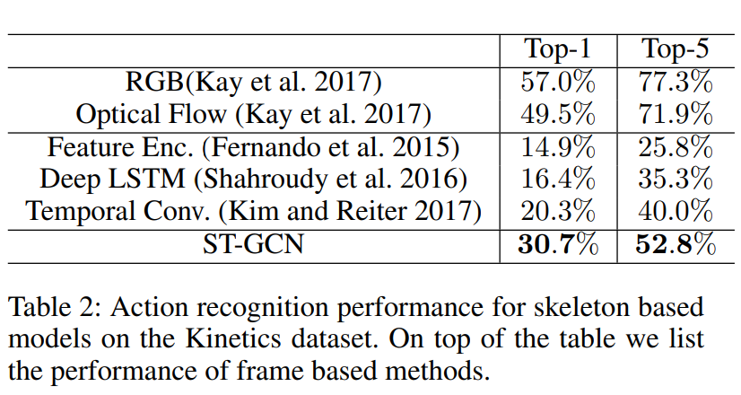
Notes:
We evaluate the recognition performance by top-1 and top-5 classification accuracy as recommended by the dataset authors (Kay et al. 2017).

Slide 23
감사합니다.

